Slide 1

Type-2 Diabetes Risk Prediction: A Data-Driven Machine Learning Approach
Authors:
Fnu Arshika Farzeen
Nitin Varma Gokaraju
Shreya Podipireddy

Slide 2
Table of content
Data Description
Attributes
Feature Selection
Data Visualization
Logistic Regression
KNN & Naïve Bayes Classifier
Support Vector Machine (SVM)
Random Forest (RF)
Conclusion
References

Slide 3
Data description
UCL Machine Learning Repository CDC Diabetes Health Indicators
The Diabetes Health Indicators Dataset contains healthcare statistics and lifestyle survey information about people in general along with their diagnosis of diabetes. The 23 features consist of some demographics, lab test results, and answers to survey questions for each patient. The target variable for classification is whether a patient is diabetic or Non-diabetic.

Slide 4
Attributes
HighBP
HighChol
BMI
Diabetes_Binary
CholCheck
Smoker
Stroke
HeartDiseaseorAttack
PhysActivity
Fruits
Veggies
HvyAlcoholConsump
AnyHealthcare
NoDocbcCost
GenHlth
MentHlth
PhysHlth
DiffWalk
Sex
Age
Education
Income

Slide 5
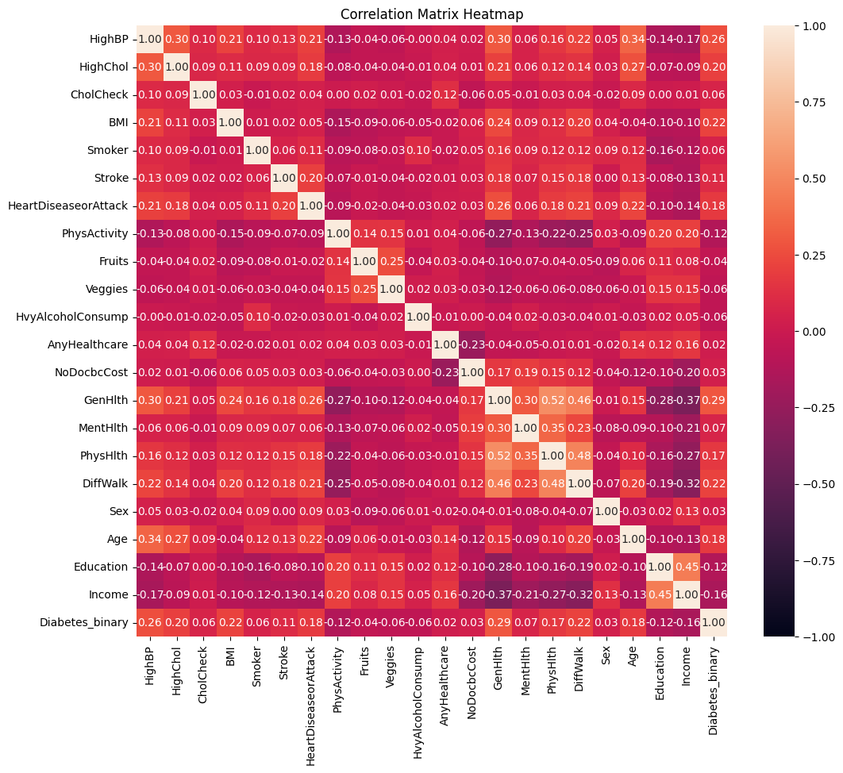
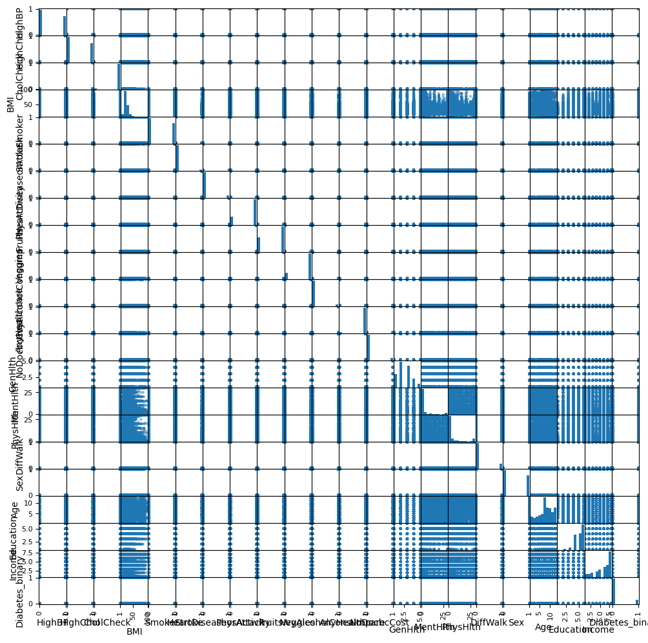
Feature selection
Diabetes_binary is the dependent variable and based on the scatter plot matrix and correlation map, key features identified for predicting diabetes include BMI, HighBP, HighChol, and Age, which showed strong positive correlations, reflecting their direct physiological link to diabetes risk. Additionally, lifestyle factors such as Smoking and General Health, with positive correlations, and Physical Activity, with a negative correlation, were selected due to their significant impact on diabetes prevalence.

Slide 6
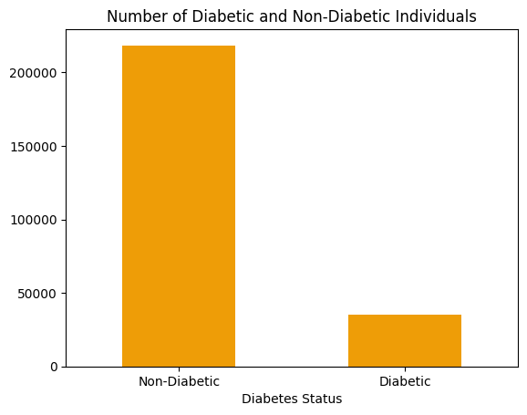
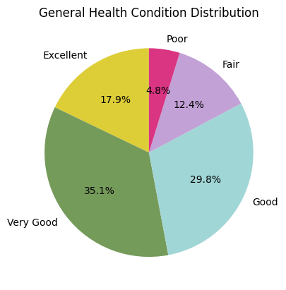
Data Visualization
The bar chart highlights the distribution of diabetes status, with over 200,000 non-diabetic individuals compared to approximately 30,000 diabetic individuals. The taller bar for non-diabetics underscores their significant dominance in the dataset.
The pie chart illustrates the distribution of respondents' self-reported health status. Most individuals rated their health positively, with 35.1% describing it as very good, 29.8% as good, and 17.9% as excellent. In contrast, 12.4% reported fair health, and only 4.8% perceived their health as poor. This data indicates that the majority have a positive outlook on their health, with a small proportion reporting negative perceptions.

Slide 7
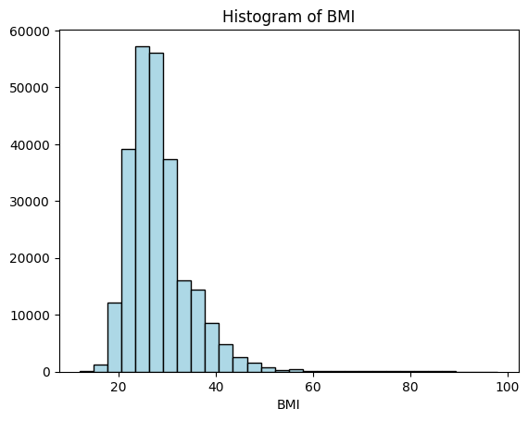
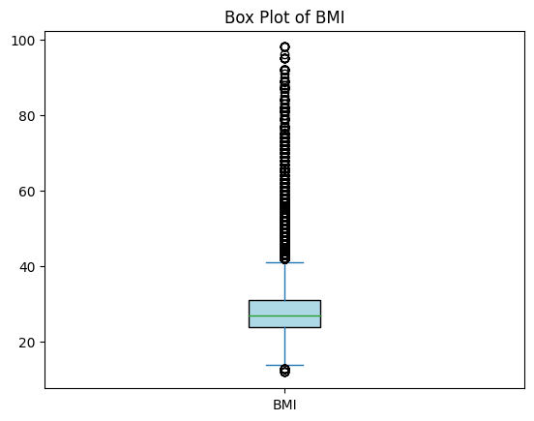
Data Visualization
The histogram of BMI reveals a slightly right-skewed distribution, with most values clustered around the mean. This pattern suggests that majority of individuals fall within a generally healthy weight range, indicating a balanced representation of BMI in the population.
The boxplot of BMI highlights the presence of outliers, with some individuals showing significantly higher BMI values compared to the majority. The central box represents the interquartile range (IQR), capturing the middle 50% of the data, while the line inside marks the median, indicating the central tendency. Outliers above the upper whisker suggest a subset of individuals at higher health risk due to elevated BMI levels.

Slide 8
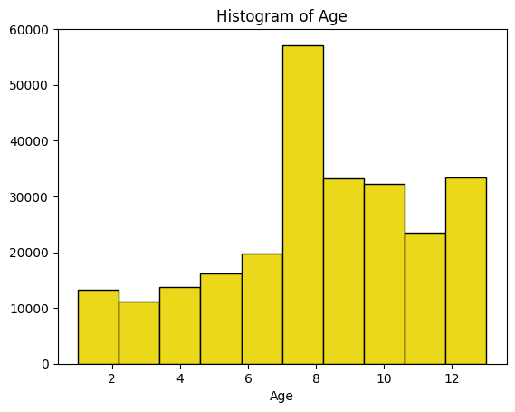
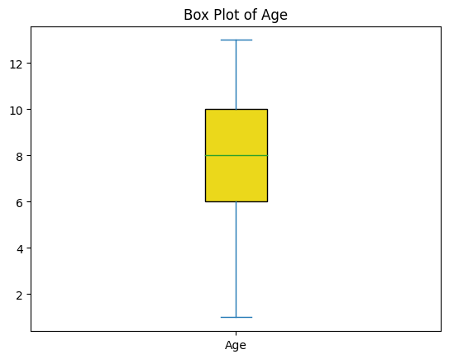
Data Visualization
The histogram of age displays a varied distribution across different age categories. This uneven distribution suggests demographic trends within the population, with peaks in specific age ranges indicating the prevalence of diabetes in those age groups.
The boxplot of age displays a wide spread of data across the different age categories, with a noticeable range in the interquartile range (IQR). The central box represents the middle 50% of the age data, indicating where most individuals fall within the age spectrum. The whiskers extend to the minimum and maximum values, illustrating the overall age distribution without any outliers.

Slide 9
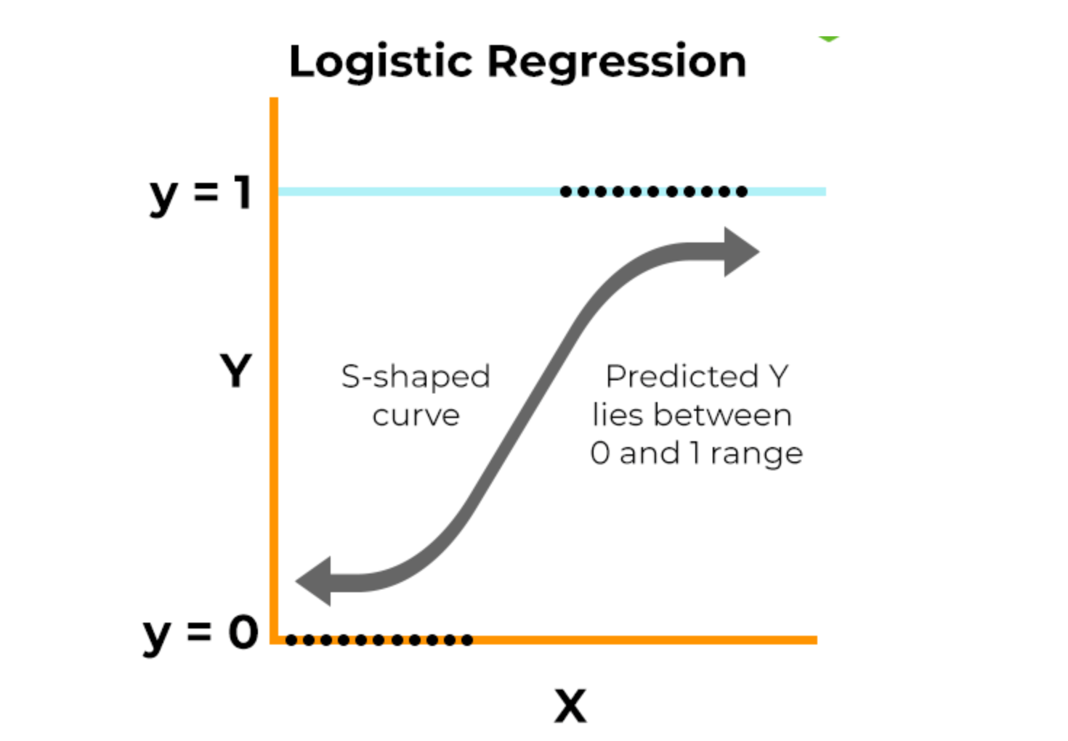
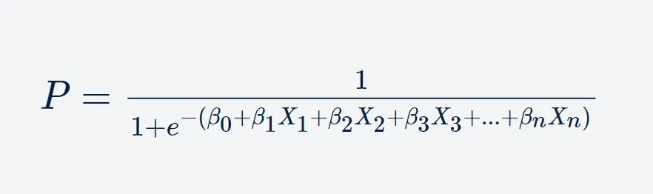
Logistic Regression
Logistic regression is a supervised machine learning algorithm that accomplishes binary classification tasks by predicting the probability of an outcome, event, or observation. The model delivers a binary or dichotomous outcome limited to two possible outcomes: yes/no, 0/1, or true/false.

Slide 10
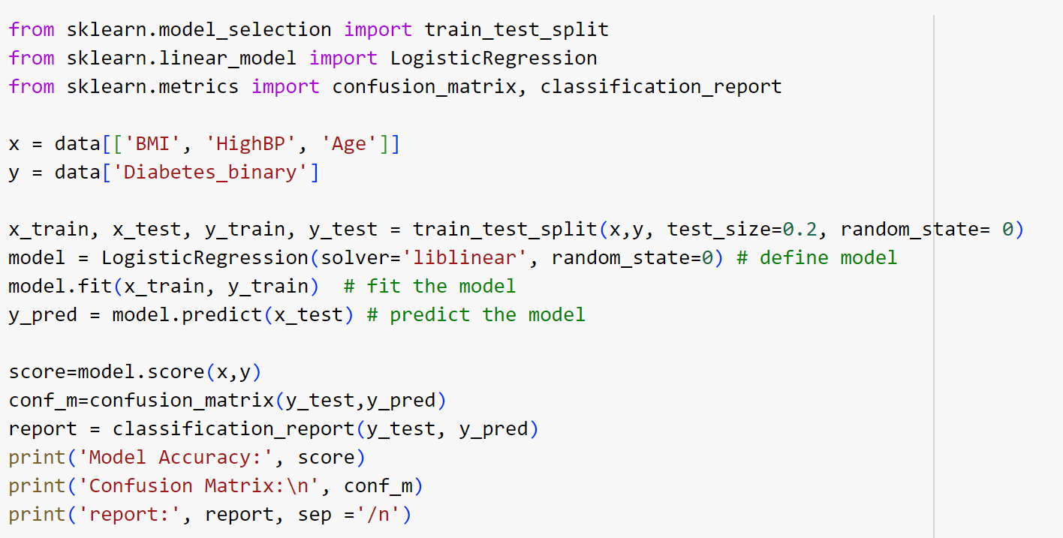
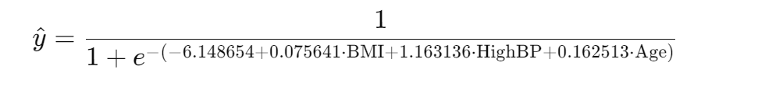
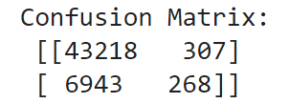
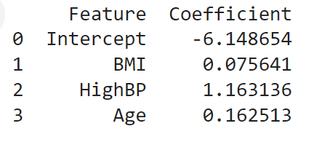
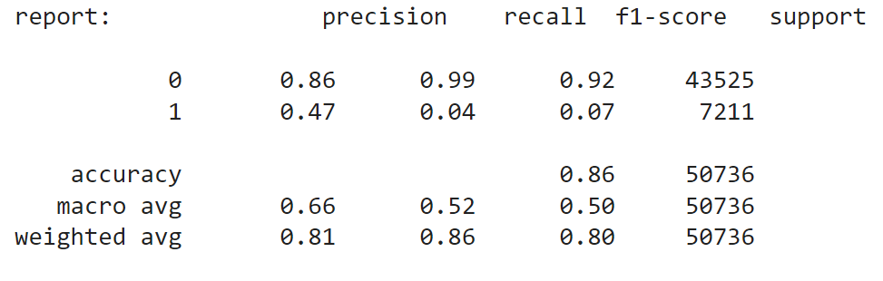
Logistic Regression
The logistic regression model achieved an overall accuracy of 85.94%, excelling in identifying non-diabetics with 43,218 correctly classified cases (86% precision, 99% recall). However, it struggled with diabetics, identifying only 268 cases (4% recall) and producing 6,943 false negatives. The low precision for diabetics (47%) and an F1-score of 0.07 highlight the model's poor effectiveness in detecting diabetic patients.

Slide 11
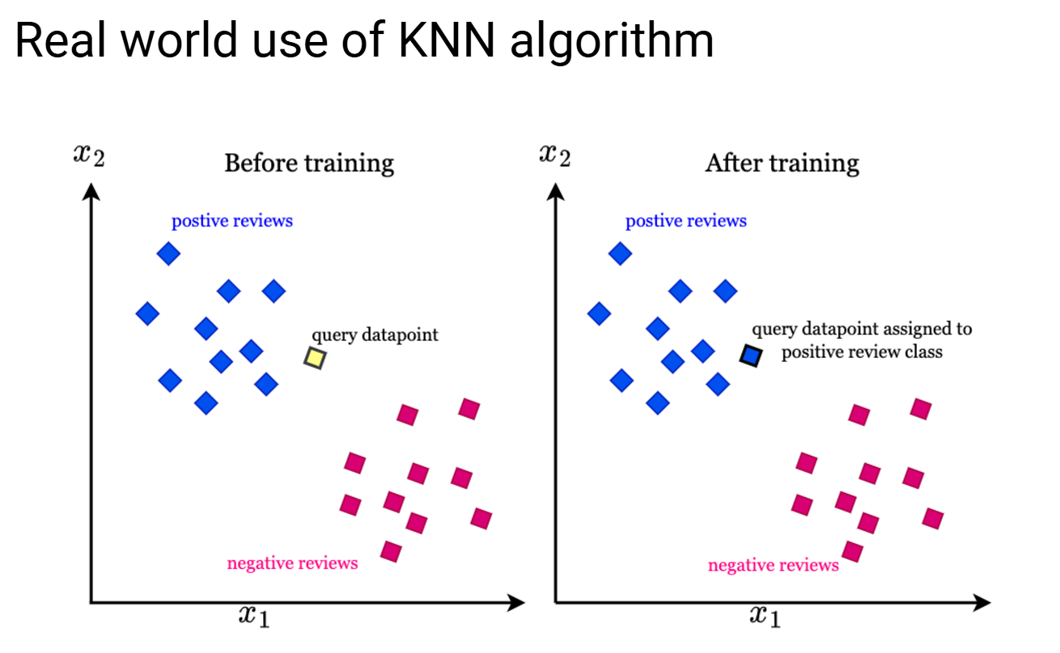
K-Nearest Neighbors (KNN)
K-Nearest Neighbors (KNN) is a simple and intuitive supervised learning algorithm used for classification and regression tasks. In classification, KNN works by identifying the 'k' nearest data points to a given test point based on a distance metric (such as Euclidean distance). The algorithm then assigns the most common class label among the k neighbors to the test point. For regression, KNN predicts the target value by averaging the values of the k nearest neighbors. KNN does not require any training phase, making it a lazy learning algorithm. It stores the entire training dataset and makes predictions during inference by computing distances to all training examples. The value of 'k' is a user-defined parameter, and it significantly influences the model's performance—smaller values of k can lead to overfitting, while larger values may cause underfitting. KNN is sensitive to the choice of distance metric and the scale of the features, making data normalization an important step in its application.

Slide 12
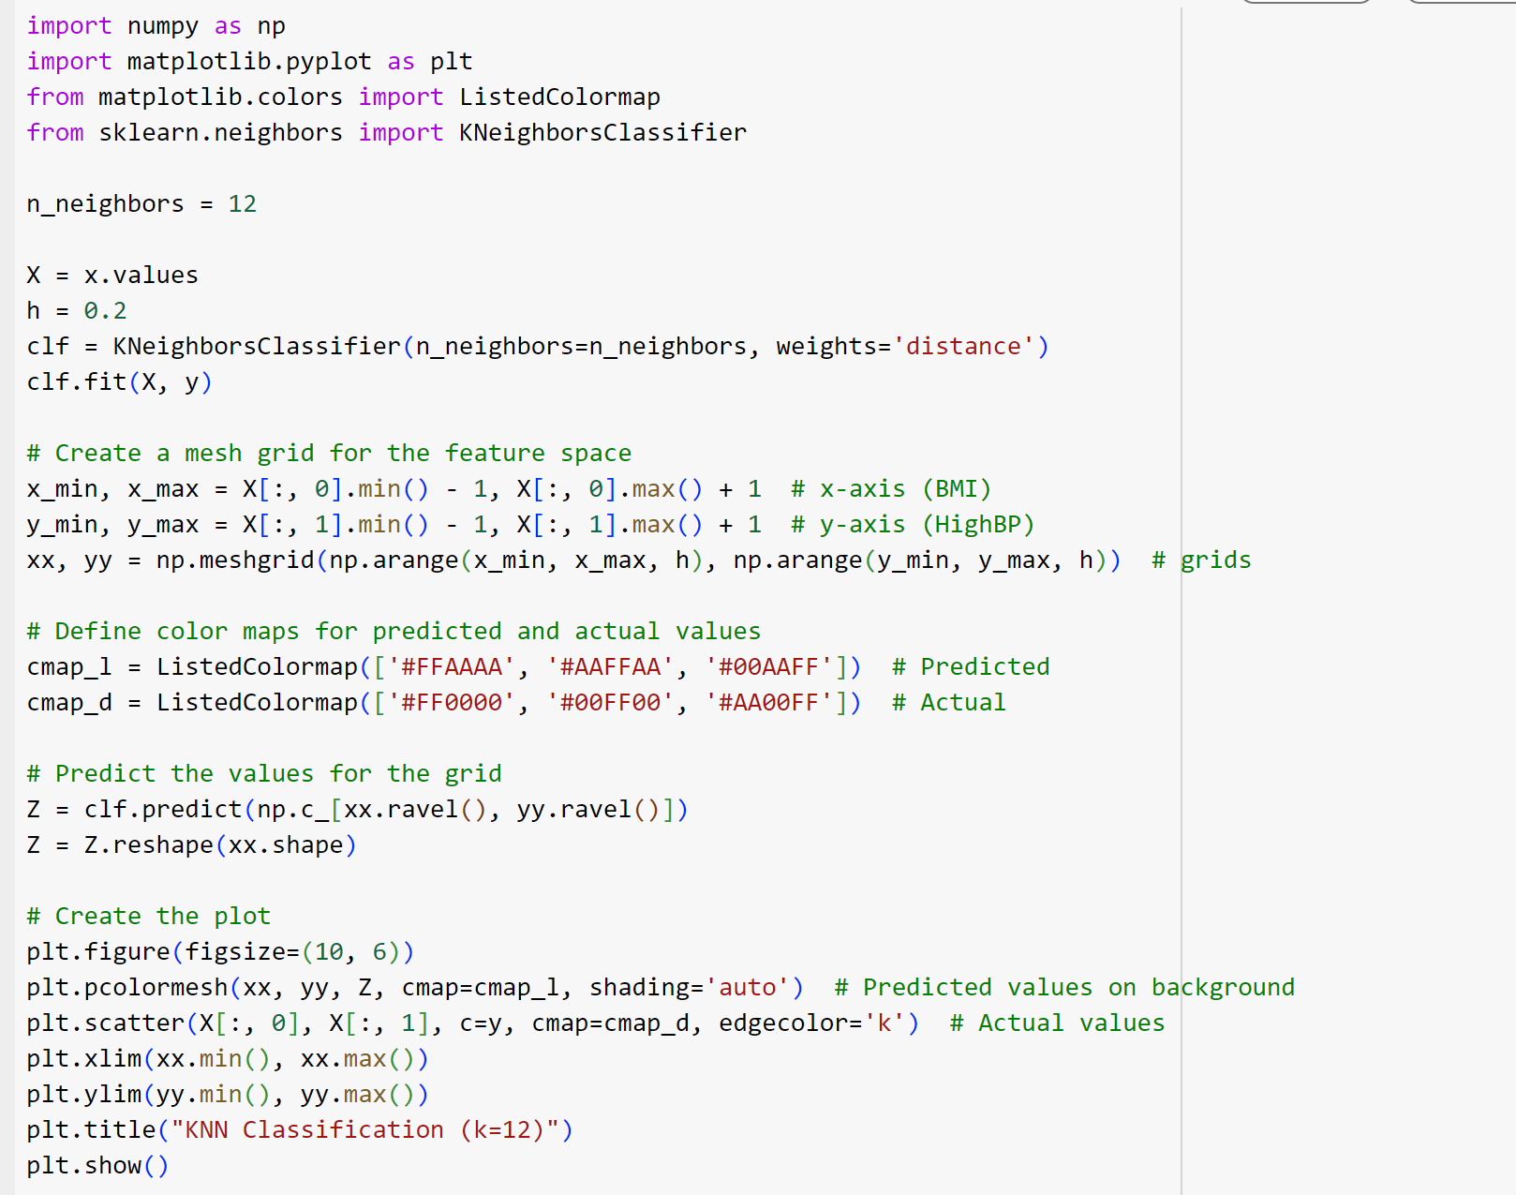
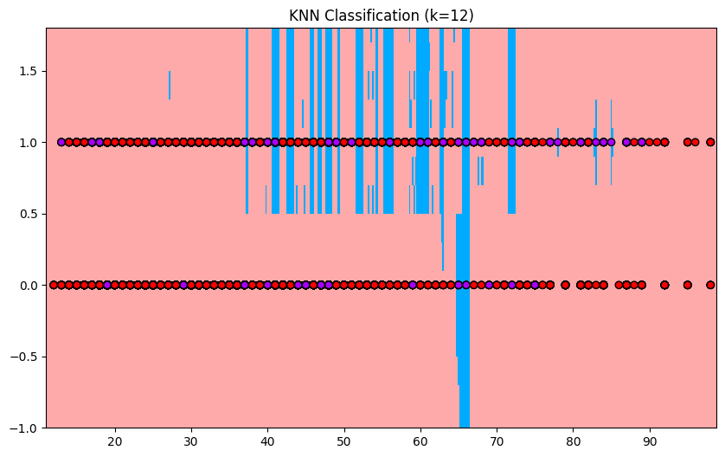
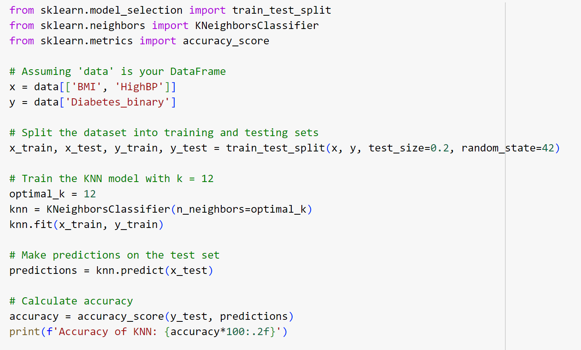
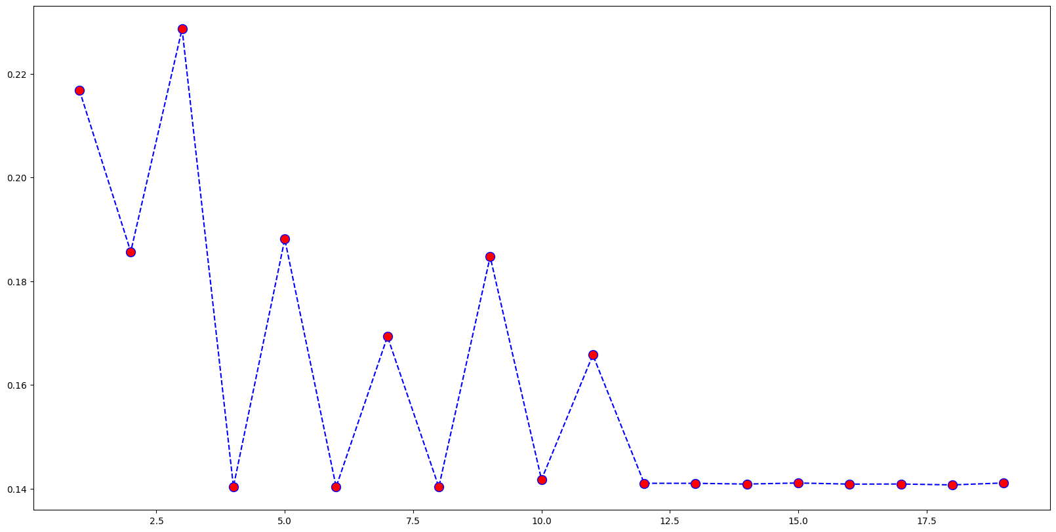
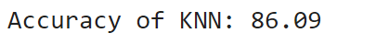
K- Nearest Neighbors(KNN) n

Slide 13
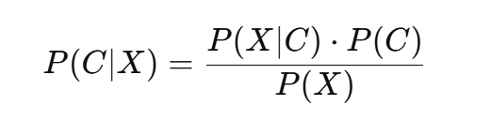
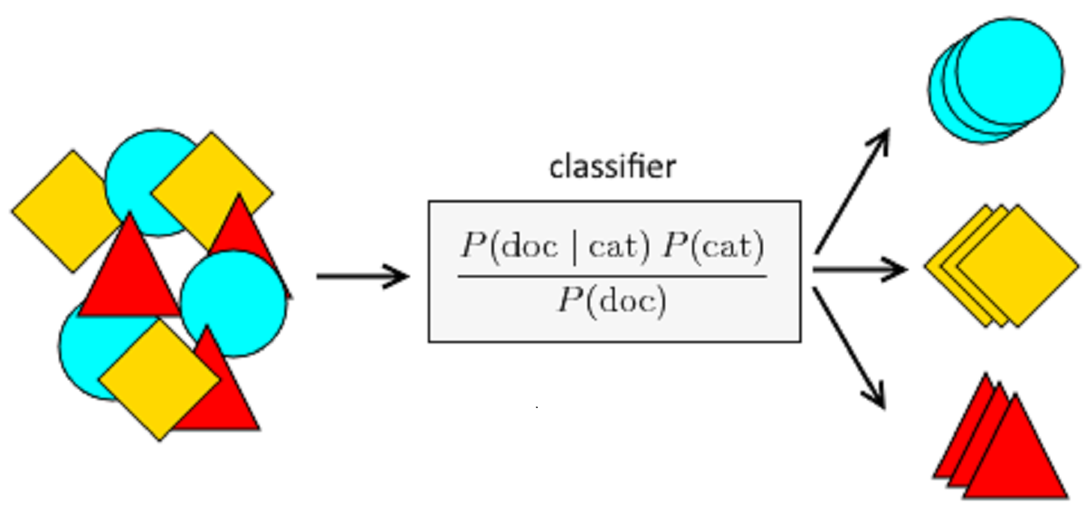
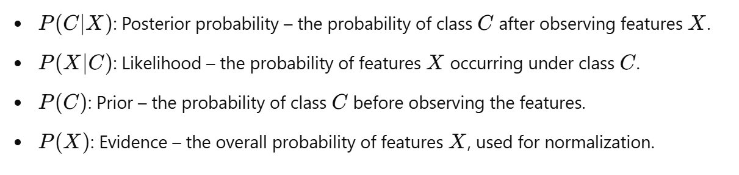
Naïve Bayes
Naive Bayes is a probabilistic machine learning algorithm based on Bayes' Theorem, used primarily for classification tasks. It assumes that features are conditionally independent given the class label, an assumption often referred to as "naive." Despite this simplification, it performs well for many real-world applications like spam filtering and text classification.

Slide 14
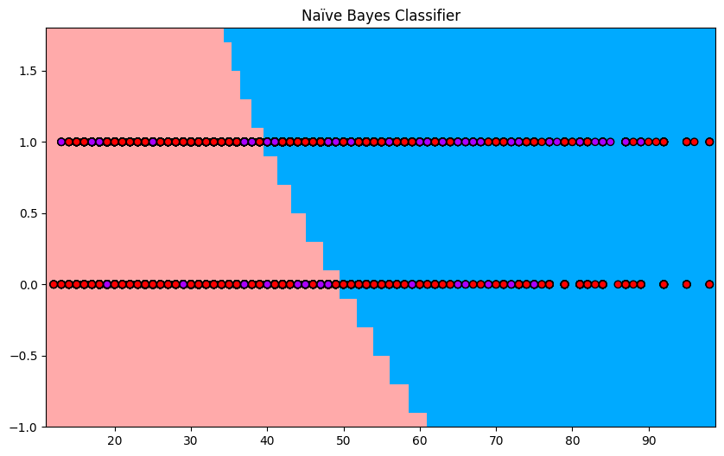
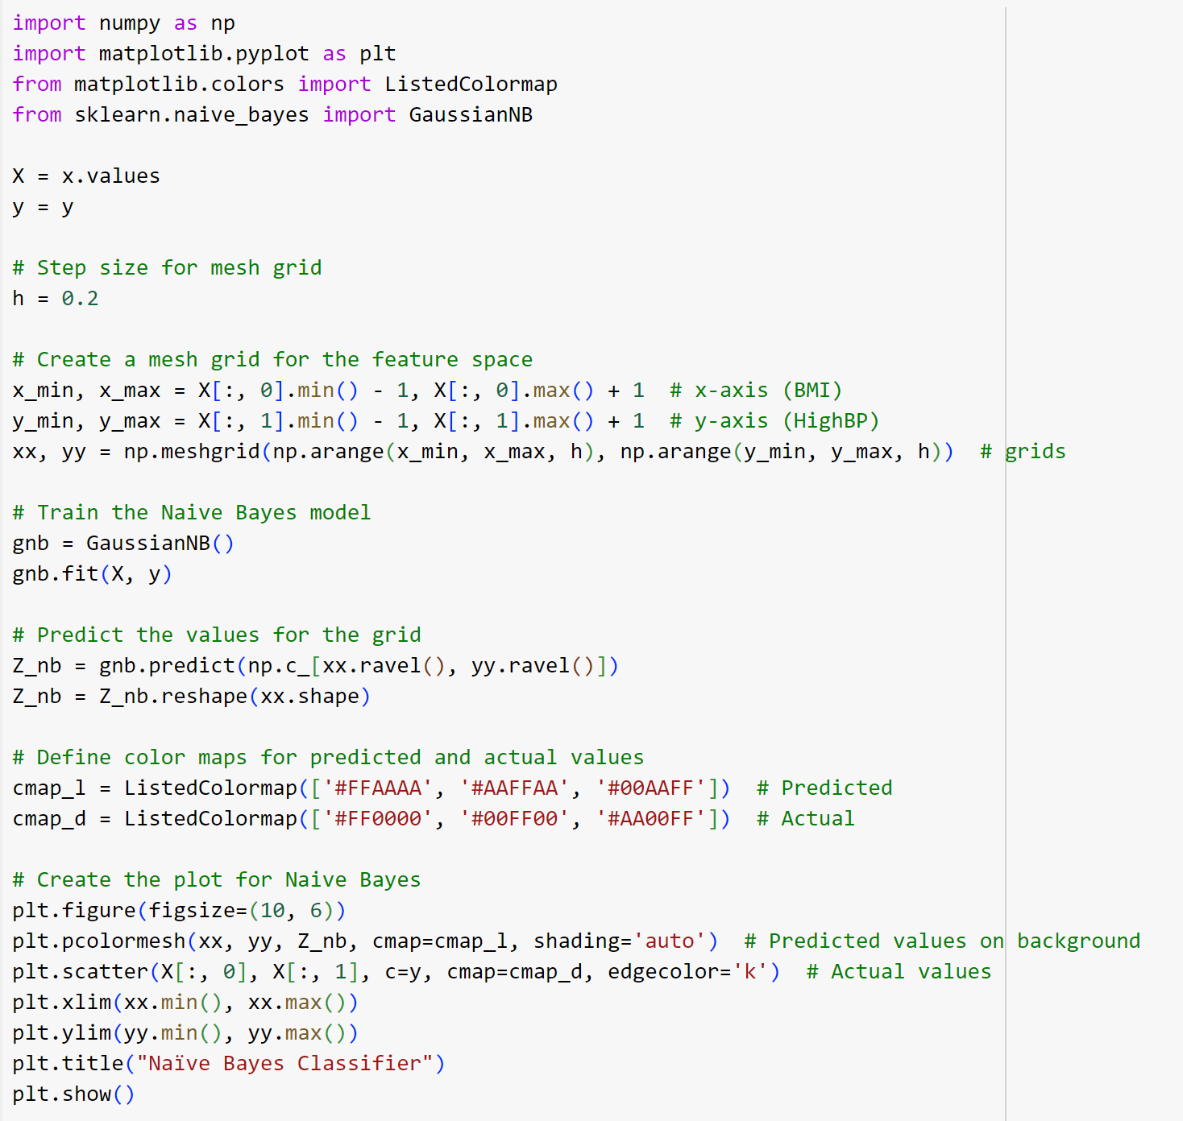
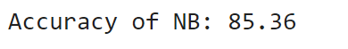
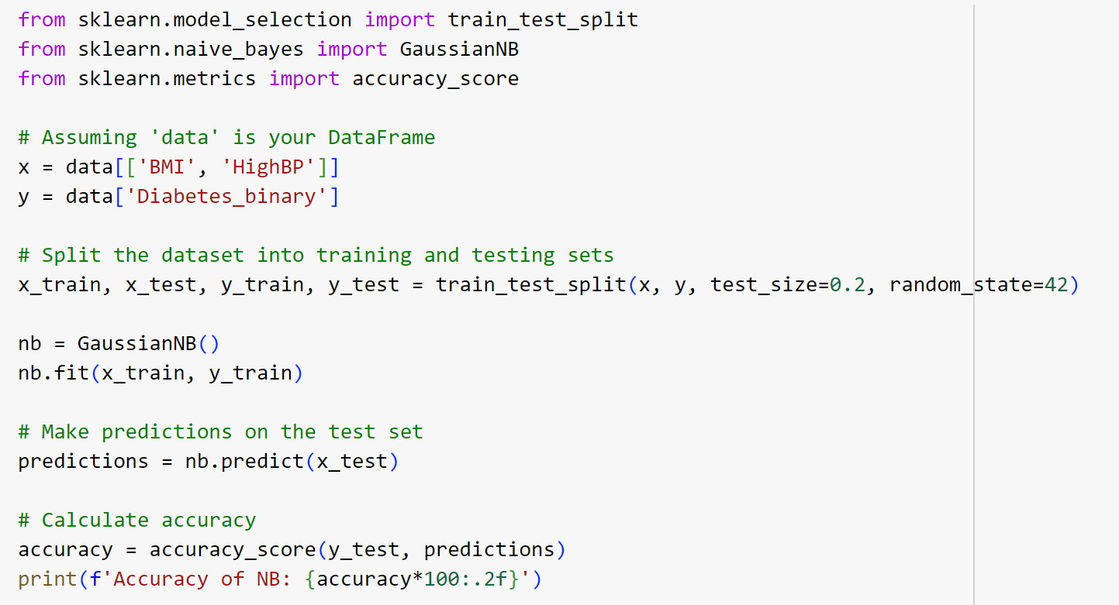
Naïve Bayes
K-Nearest Neighbors (KNN) and Naive Bayes (NB) both demonstrated strong performance on this dataset. KNN achieved an accuracy of 86.09%, slightly higher than Naive Bayes' 85.36%. This minor advantage highlights KNN's suitability for this dataset, as it leverages the proximity of neighboring data points for predictions. While Naive Bayes remains a reliable option, KNN's ability to capture local patterns gives it a slight edge, making it the preferred model for this analysis.

Slide 15
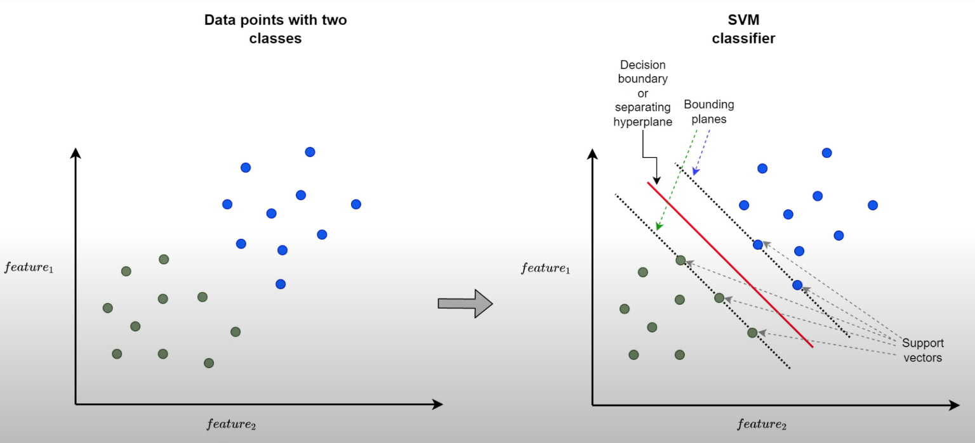
Support Vector Machine (SVM)
Support Vector Machine (SVM) is a supervised machine learning algorithm used for both classification and regression tasks. It works by identifying the optimal hyperplane that separates data points of different classes in a feature space, maximizing the margin the distance between the hyperplane and the nearest data points from each class, known as support vectors. This maximization improves the model's ability to generalize to unseen data. For linearly separable data, SVM constructs a straight hyperplane, while for non-linearly separable data, it employs the kernel trick to transform the data into a higher-dimensional space, enabling linear separation. Common kernel functions include linear, polynomial, radial basis function (RBF), and sigmoid.

Slide 16
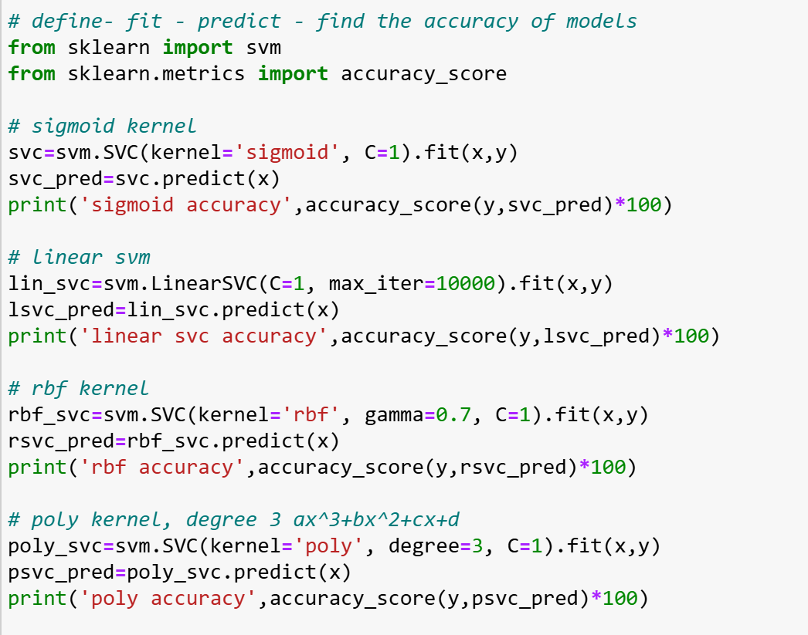
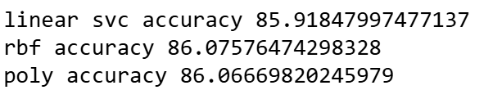
Support Vector Machine (SVM)
The accuracy of the four SVM models of the data with two features BMI and HighBP and target column as Diabetes binary, shows varying performance, with the Linear SVC and RBF kernels achieving the highest accuracy. The Sigmoid kernel model, with an accuracy of 76.63%, performs the lowest, indicating that the Sigmoid kernel may not be the most suitable for the data. The Linear SVC, with an accuracy of 85.92%, demonstrates a strong performance, suggesting that a linear decision boundary fits the data well. The RBF kernel slightly outperforms the Linear SVC, achieving an accuracy of 86.08%, indicating that the RBF kernel, with its ability to handle non-linear relationships, provides a more flexible decision boundary for this dataset. The Polynomial kernel, with an accuracy of 86.07%, performs similarly to the RBF kernel, showing that the polynomial kernel’s degree 3 decision boundary also offers a good fit. Overall, the RBF and Polynomial kernels perform the best, with marginally better results than the Linear SVC. This suggests that while a linear model can still provide good results, non-linear kernels may offer slightly superior performance when dealing with more complex decision boundaries in this case.

Slide 17
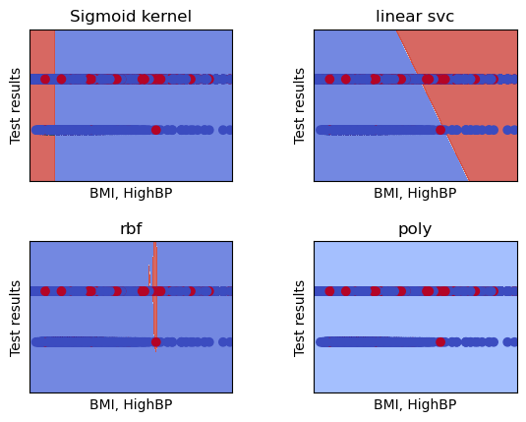
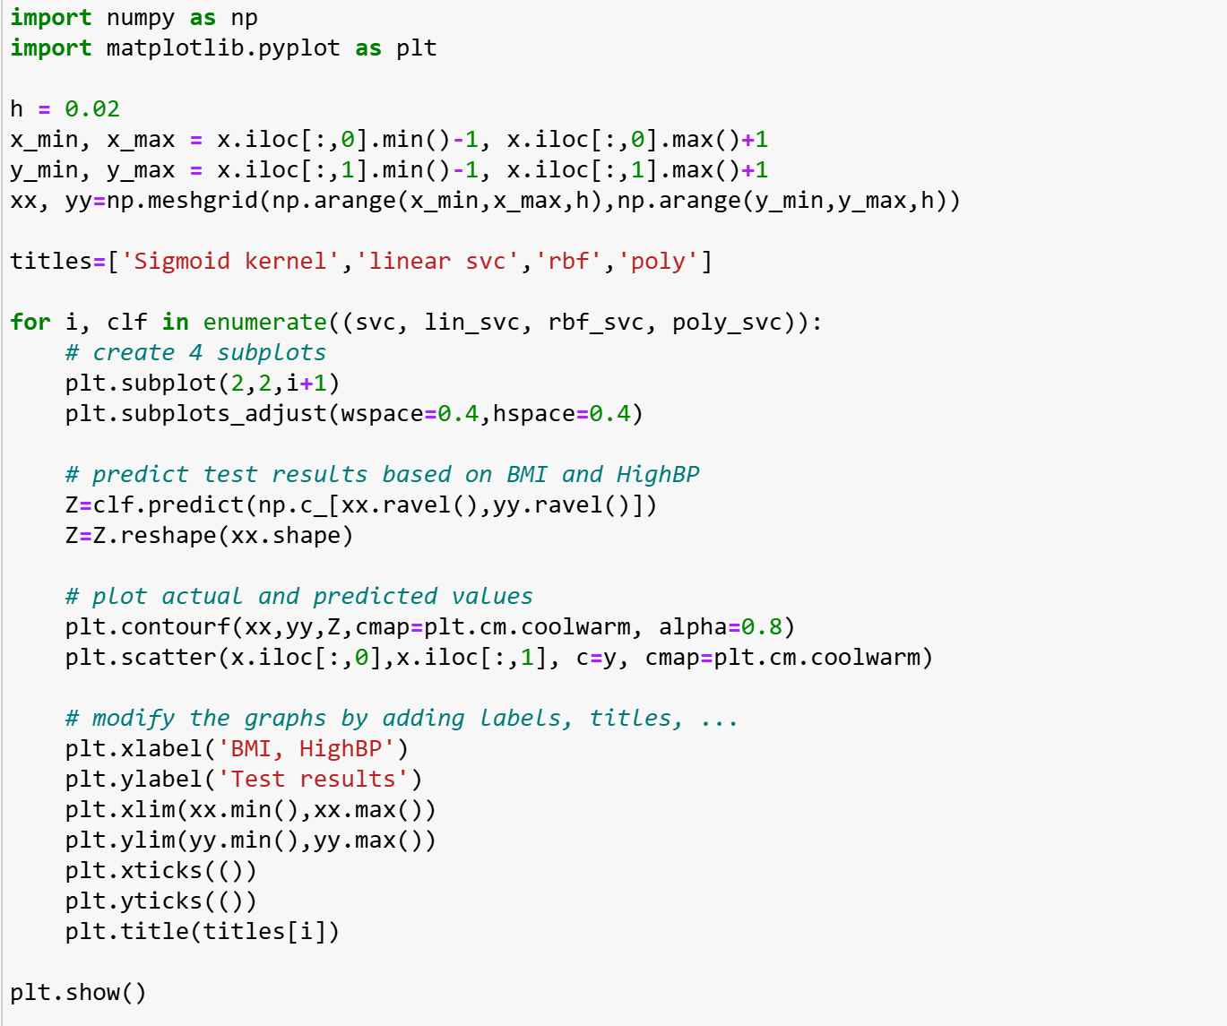
Support Vector Machine (SVM)
The four graphs illustrate decision boundaries generated by different SVM kernels (Sigmoid, Linear, RBF, and Polynomial) based on a data with two features BMI and HighBP and target column as Diabetes binary. The red and blue regions represent different classifications of test results. The Sigmoid kernel produces a relatively simple, almost linear boundary, with limited ability to capture complex patterns, which aligns with its lower accuracy (76.63%) compared to the other models. The Linear SVC, as expected, shows a straight-line decision boundary, which is clear and straightforward but may miss nuances in more complex data patterns, achieving an accuracy of 85.92%. The RBF kernel demonstrates a more complex, non-linear boundary that more precisely captures variations in the data, resulting in the highest accuracy (86.08%). Similarly, the Polynomial kernel (degree 3) forms a smooth, non-linear boundary suited for data with polynomial patterns, with an accuracy close to that of the RBF kernel (86.07%). Overall, the RBF and Polynomial kernels appear better suited for this dataset, likely due to their ability to capture non-linear relationships, while the Sigmoid and Linear kernels provide simpler, less adaptive boundaries.

Slide 18
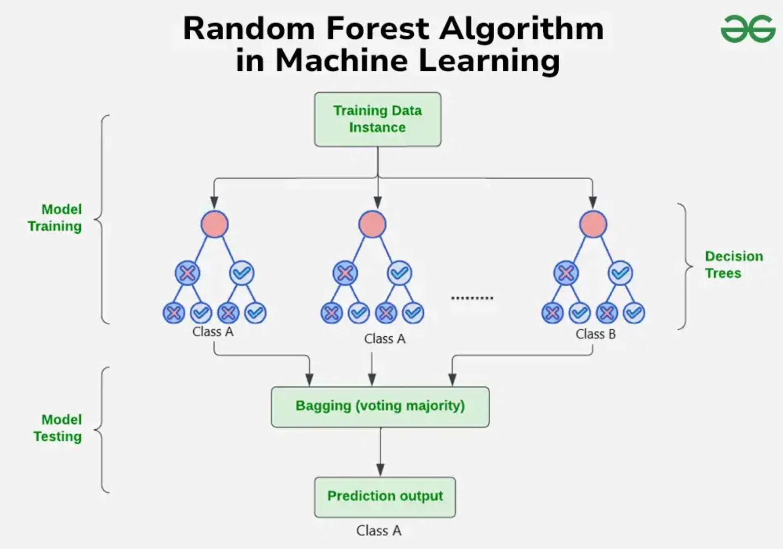
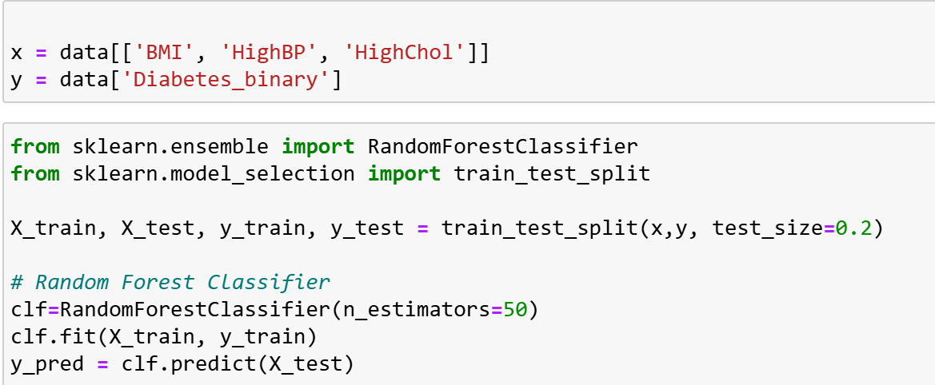
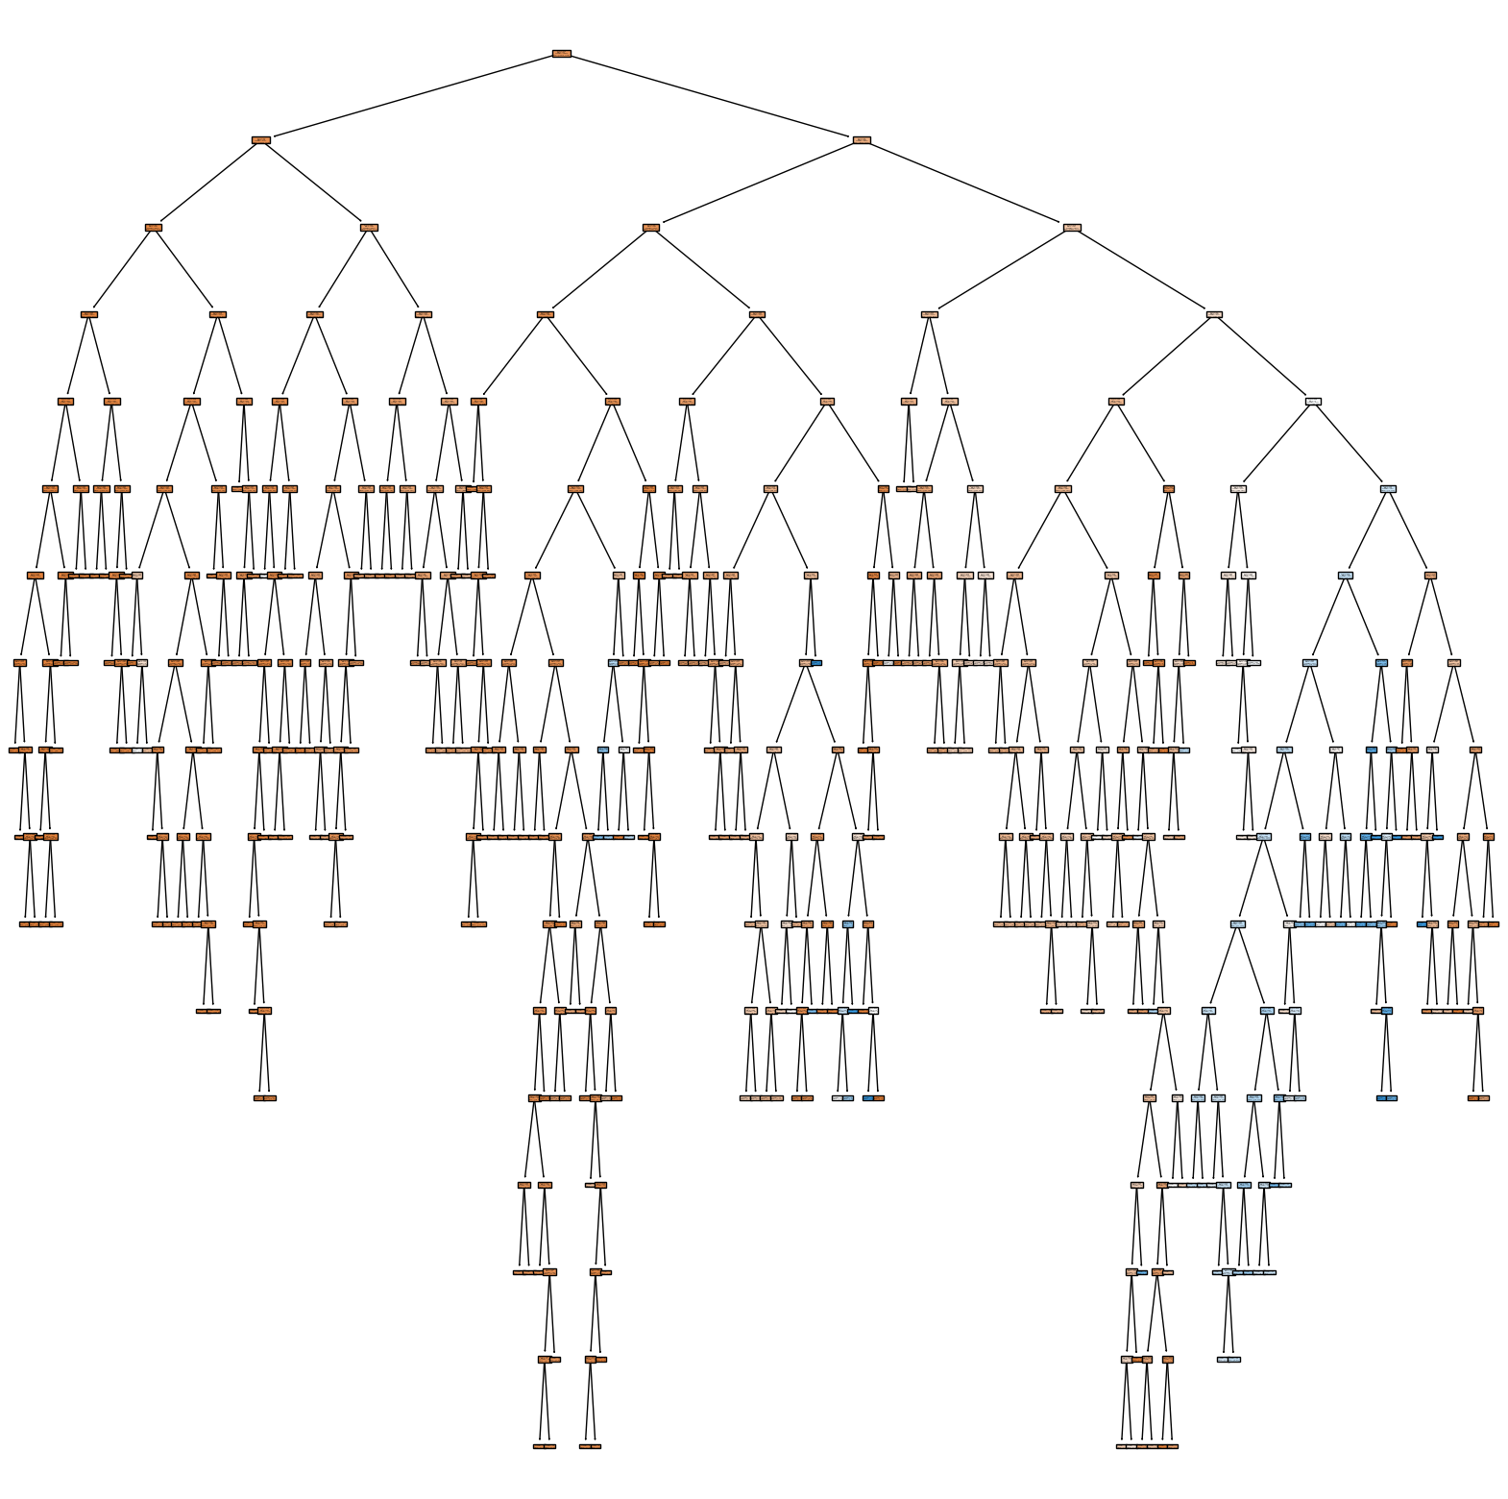
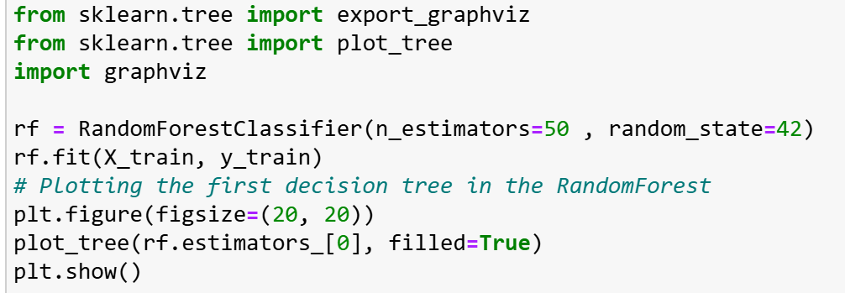
Random Forest (RF)

Slide 19
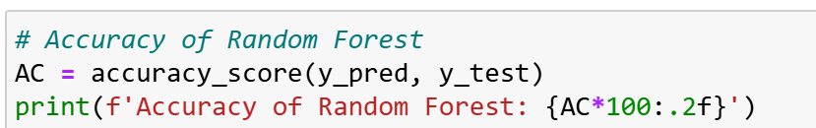
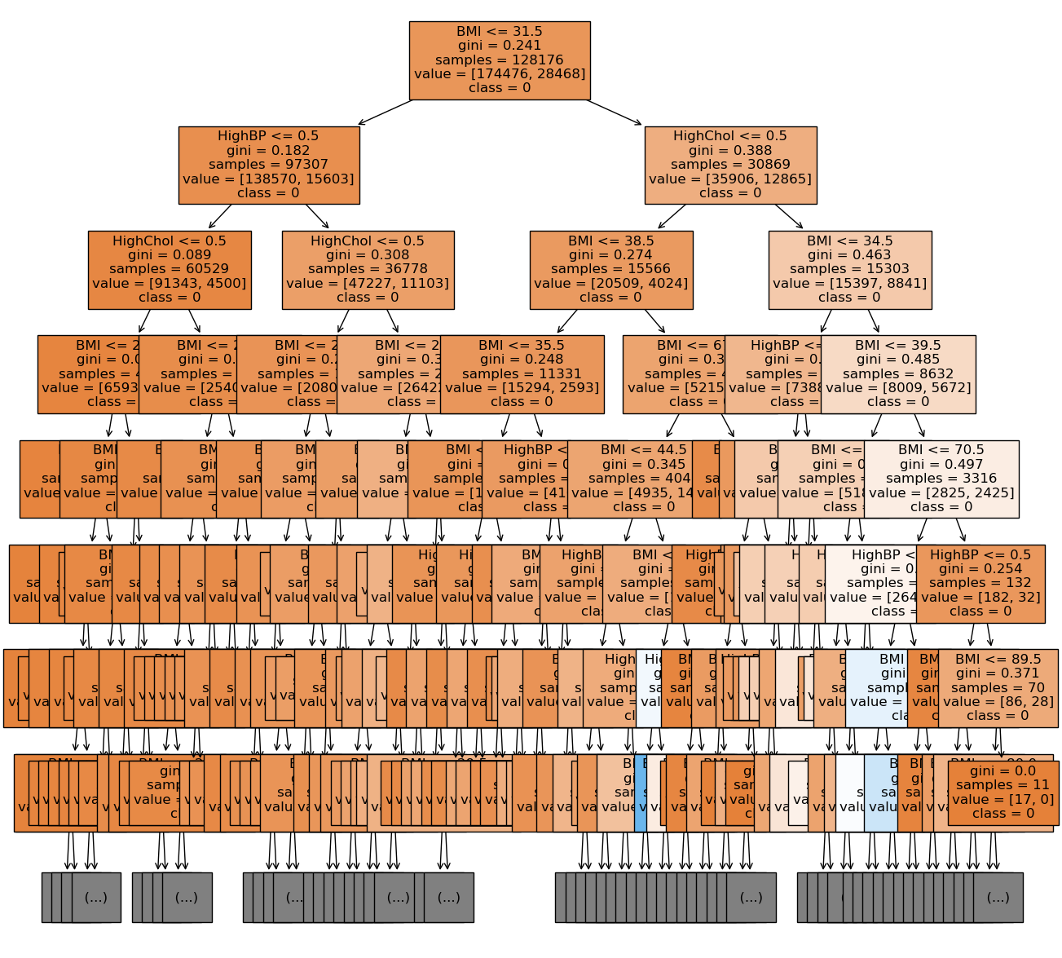
Random Forest (RF)
Random Forest (RF) is an ensemble learning technique that constructs multiple decision trees during training and combines their predictions to improve accuracy and robustness. Each tree is trained on a random subset of data and features, ensuring diversity and reducing the risk of overfitting. By aggregating predictions, typically through majority voting for classification, Random Forest effectively handles complex patterns and interactions between features while remaining resilient to noise. In this case, the model was trained on features such as BMI, High Blood Pressure (HighBP), and High Cholesterol (HighChol) to predict a binary outcome for diabetes. The classifier achieved an accuracy of 86.35%, correctly predicting diabetes outcomes in about 86% of test cases. This result highlights the model's ability to capture meaningful relationships between the features and the target variable.

Slide 20
Conclusion
Our project on Type-2 Diabetes Risk Prediction utilized a dataset of 23 attributes to identify key predictors, including BMI, High Blood Pressure (HighBP), and High Cholesterol (HighChol), which were used in building all models due to their strong correlation with diabetes risk. Random Forest emerged as the best performer with an accuracy of 86.35%, followed closely by KNN, Naive Bayes, and SVM using RBF and Polynomial kernels. These models effectively leveraged the selected features to capture patterns and interactions. However, the dataset's class imbalance hindered sensitivity in identifying diabetic cases, leading to lower precision for this minority class. To address these limitations, we recommend applying techniques such as re-sampling, adjusting class weights, and refining features to enhance the model's precision and sensitivity, making it a more effective tool for early diabetes risk prediction.

Slide 21
References
Ren X. Predictions of diabetes through machine learning models based on the health indicators dataset. Applied and Computational Engineering. 2024;32(1):216-222. doi:10.54254/2755-2721/32/20230214
Chang V, Ganatra MA, Hall K, Golightly L, Xu QA. An assessment of machine learning models and algorithms for early prediction and diagnosis of diabetes using health indicators. Healthcare Analytics. 2022;2:100118. doi:10.1016/j.health.2022.100118
Horestani FJ, O MMO. Predicting Diabetes with Machine Learning Analysis of Income and Health Factors Detection. Software Engineering. Published online April 20, 2024:137-154. doi:10.5121/csit.2024.140711
Bele R. Naive Bayes theorem in machine learning. Published June 3, 2023. https://www.linkedin.com/pulse/naive-bayes-theorem-machine-learning-rohit-bele/

